Slide 1
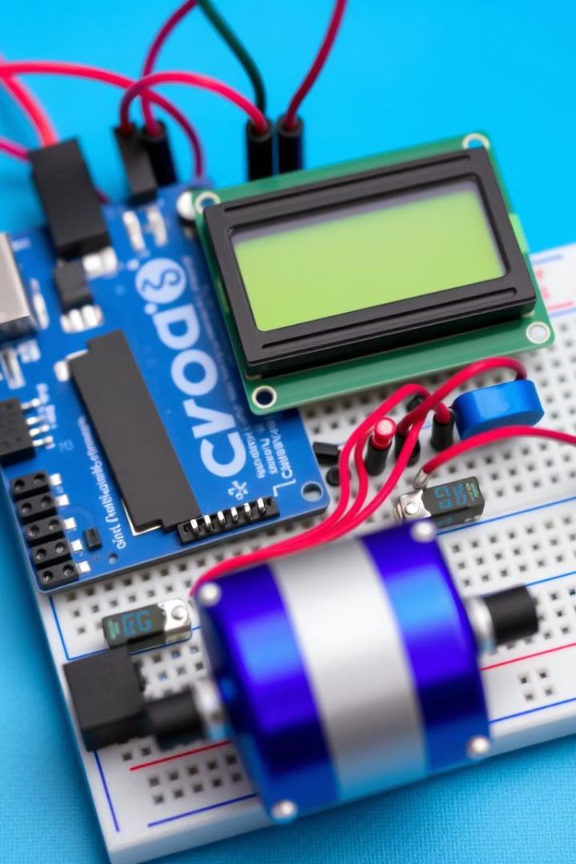

Arduino-based DC Motor Speed Control Project
This project demonstrates a practical application of Arduino for controlling a DC motor's speed and monitoring its rotation using a hall sensor.
by Roshan Hemrajani

Slide 2
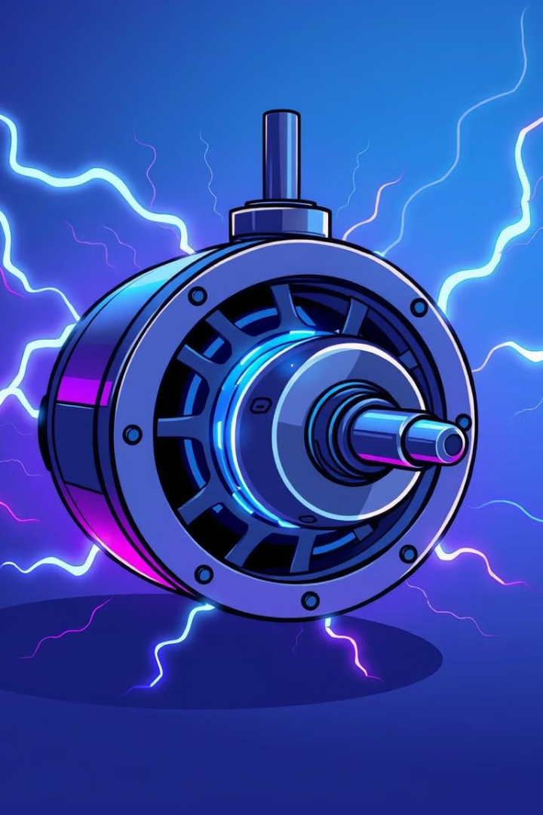
Introduction to the Project
Purpose
Functionality
The project aims to control the speed of a DC motor using an Arduino board.
The system will use a hall sensor to detect the motor's shaft rotation and update a 16x2 LCD display with the speed.
Components
The project utilizes an Arduino Uno, a 16x2 LCD, a hall sensor, a DC motor, and a voltage regulator.

Slide 3
Components Used
Arduino Uno
16x2 LCD
Hall Sensor
The Arduino Uno is the microcontroller responsible for controlling the motor speed and updating the LCD.
The 16x2 LCD displays the current RPM (rotations per minute) of the motor shaft.
The hall sensor detects the magnet attached to the motor shaft, providing a pulse for each rotation.

Slide 4





Circuit Diagram and Connections
Arduino Uno
Hall Sensor
DC Motor
Voltage Regulator
The Arduino Uno receives input from the hall sensor and controls the motor speed.
The hall sensor is connected to an interrupt pin on the Arduino Uno to detect motor shaft rotations.
The DC motor is connected to the Arduino Uno's PWM pin to adjust its speed.
The voltage regulator provides a stable voltage to the DC motor.

Slide 5
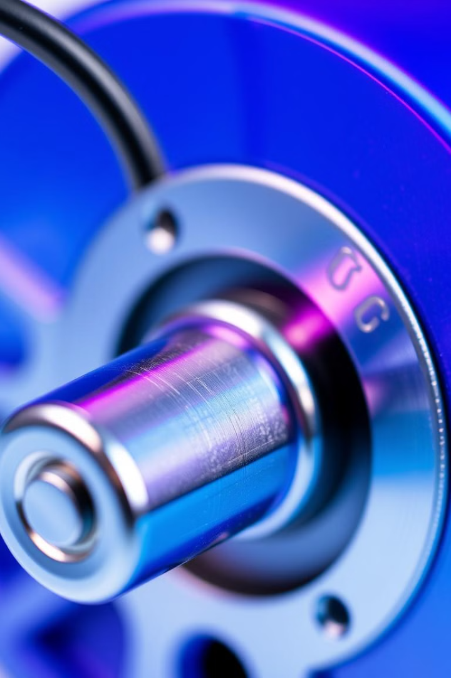


Magnet Attached to Motor Shaft
Magnet
Rotation
A small magnet is attached to the motor shaft to trigger the hall sensor.
As the motor shaft rotates, the magnet passes the hall sensor, generating a pulse.

Slide 6

Hall Sensor Detecting Magnet Passing
1
Hall Effect
2
Pulse Generation
The hall sensor detects changes in the magnetic field caused by the passing magnet.
Each time the magnet passes the sensor, it triggers a pulse signal sent to the Arduino.

Slide 7
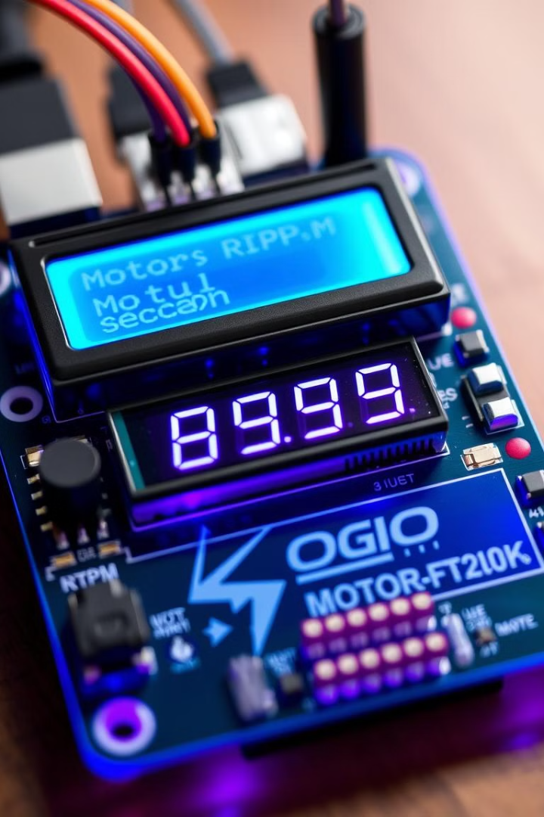
Arduino Counting Shaft Rotations and Updating LCD
1
Pulse Counting
The Arduino counts the number of pulses generated by the hall sensor.
2
Speed Calculation
The Arduino calculates the motor's speed in RPM based on the pulse count and the time interval.
3
LCD Display
The Arduino updates the 16x2 LCD with the calculated motor speed.

Slide 8
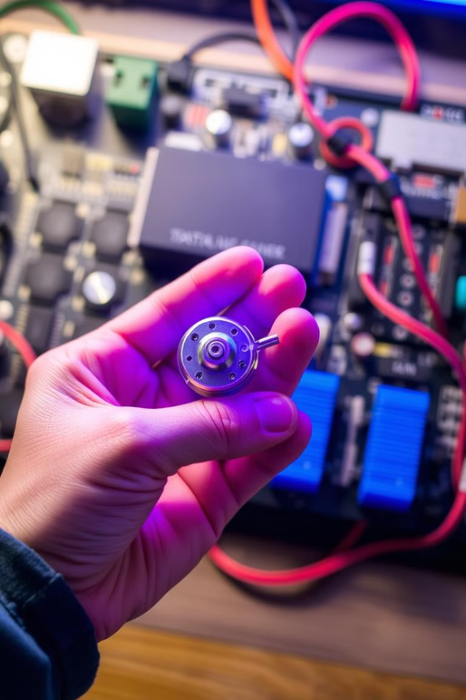
Conclusion and Potential Applications
Conclusion
This Arduino-based project successfully controls the speed of a DC motor and monitors its rotation.
Applications
This project can be applied to various scenarios, such as controlling fans, pumps, and robotic actuators.

